Slide 1
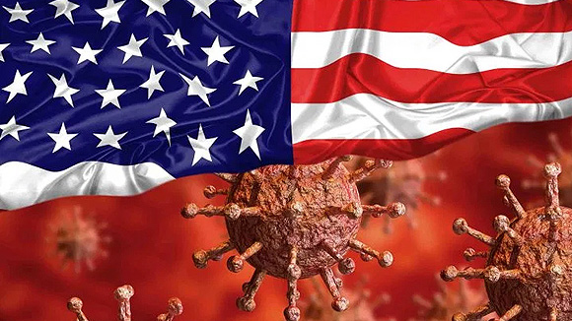
Politics of a Pandemic
Team Members: Cody Tong | Daniel Rossi | Fatima Carrillo | Geoff Farrell | Jackie Huang | William Pryor
Resources: The COVID Tracking Project
Kaggle 2016 U.S. Presidential Election
US Census
This Photo by Unknown Author is licensed under CC BY-SA-NC

Slide 2
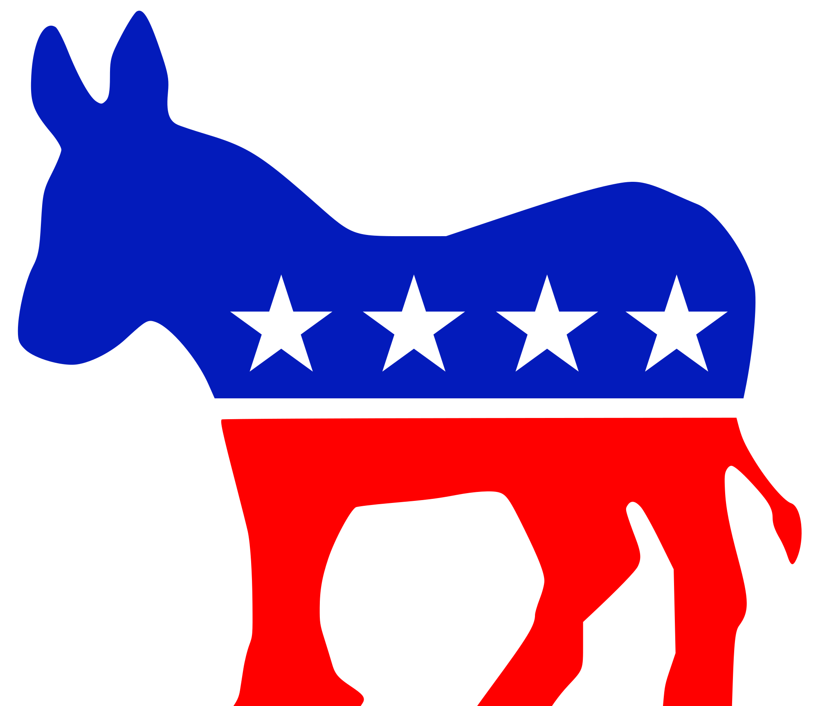

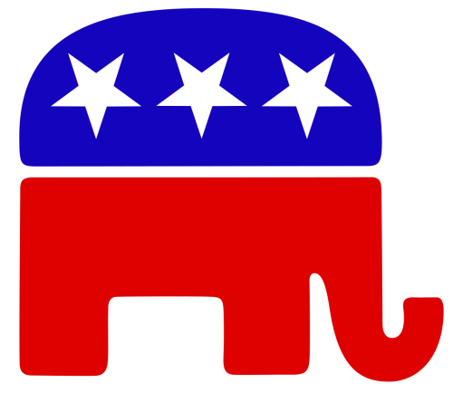
Overview
How did different US states fare during the COVID19 pandemic in terms of cases and deaths?
Is there a direct correlation between state political party preference and COVID cases and deaths by state?
Why does the analysis trend more heavily on one side, if at all?
Notes:
Fatima

Slide 3



Three main data sources used for analysis
The COVID Tracking Project: COVID19 test statistic data
Kaggle, 2016 U.S. Presidential Elections
3. U.S. Census, 2019 Data
Notes:
Fatima
We utilized several csv files for each resource and combined them by state and county.
On the NY Times files we utilized the death data, positive / negative total by state
For the Kaggel 2016 Presidential data we used 2016 which was broken down by state and county for those who voted Republican and Democratic
The US Census 2019 population estimates

Slide 4
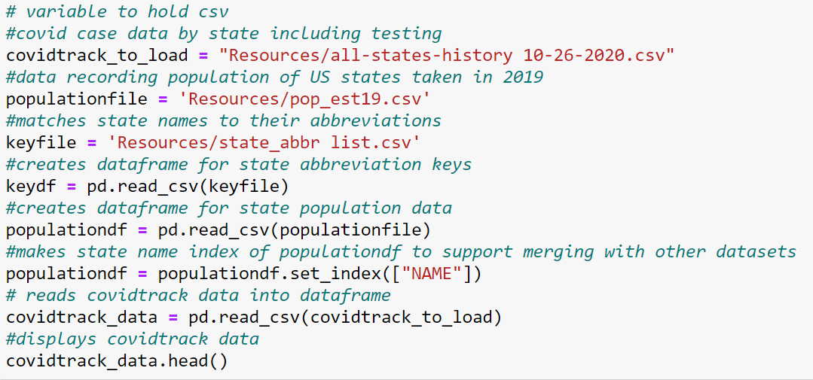
Pandas Code: Loading in .CSV resources
Notes:
Geoff

Slide 5
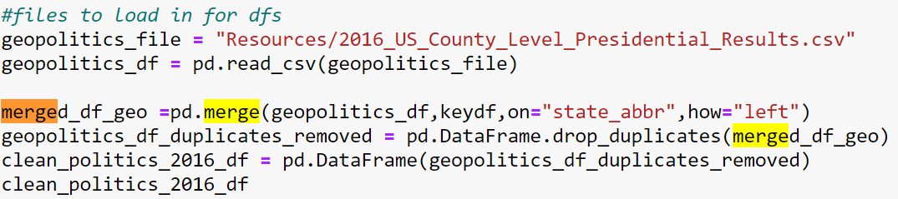
Pandas Code: Merging Dataframes
Notes:
Geoff

Slide 6
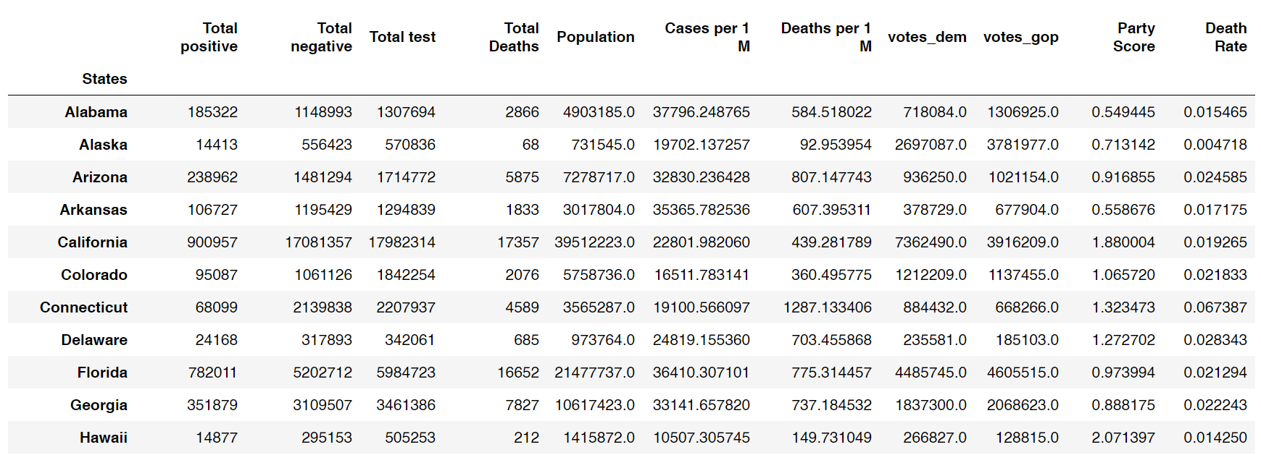
Combined Dataframe with State Political Preference and COVID19 Data
Notes:
Geoff

Slide 7
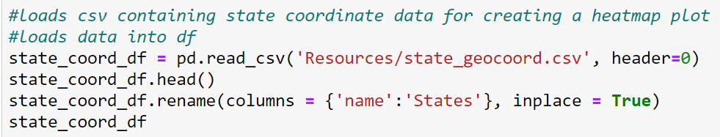
Pandas Code: Dataframe with State Coordinate Data for Creating Heatmaps
Notes:
Geoff

Slide 8
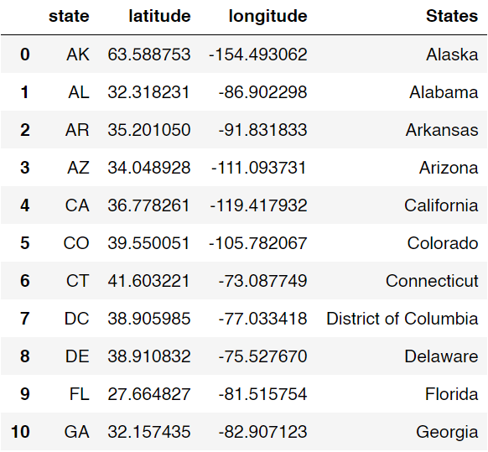
Pandas Dataframe with State Coordinate Data for Creating Heatmaps
Notes:
Geoff

Slide 9
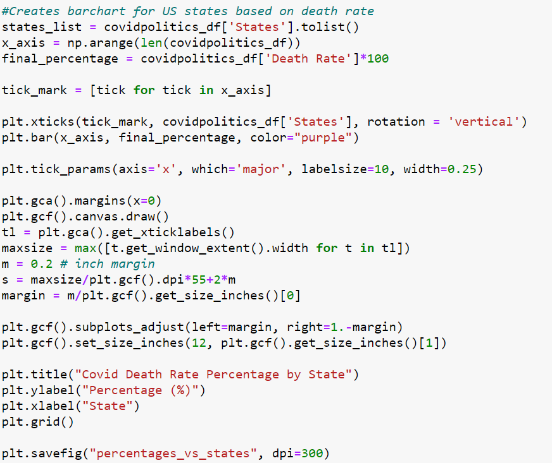
Matplotlib Code: COVID19 Deaths Per States Barchart
Notes:
William

Slide 10
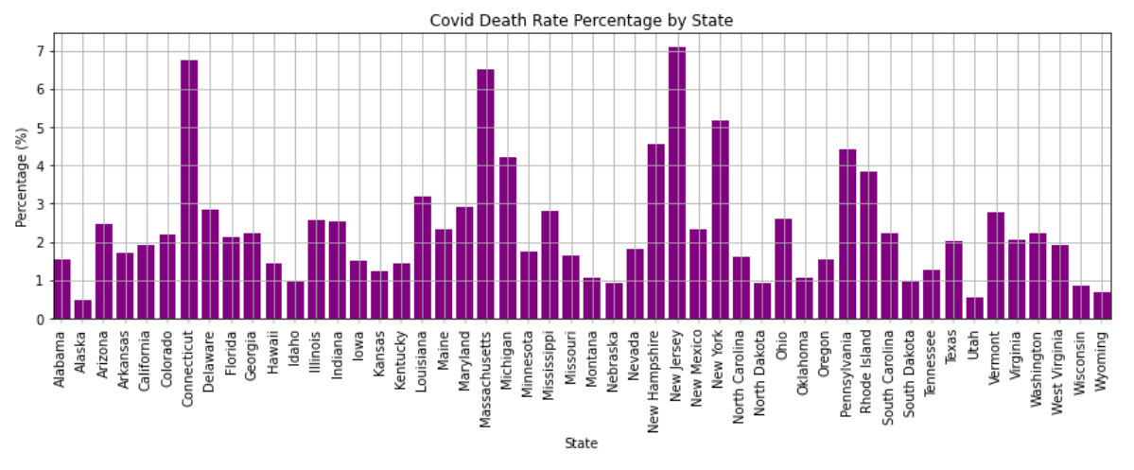
Notes:
William

Slide 11
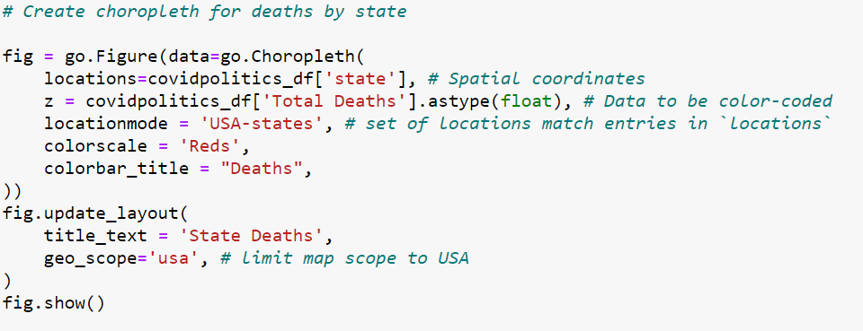
Choropleth: Heatmap Code Example
Notes:
Cody

Slide 12
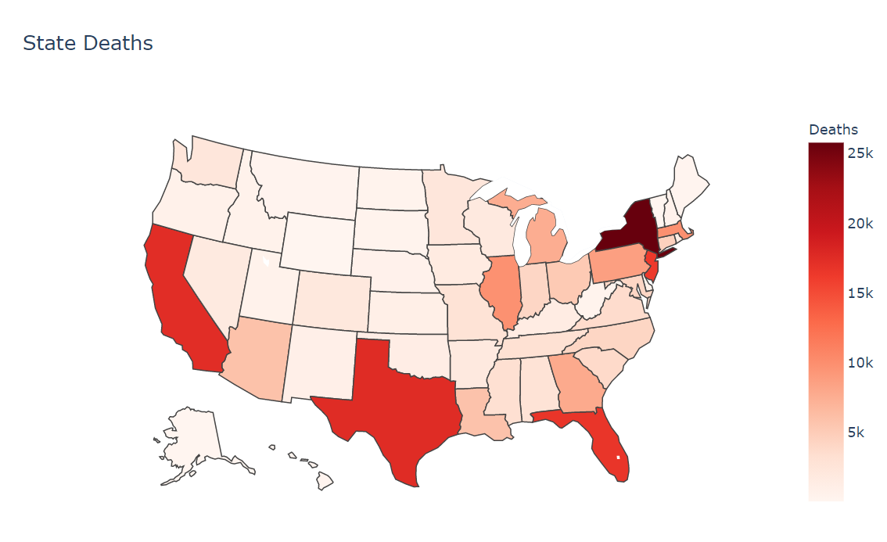
Notes:
Cody

Slide 13
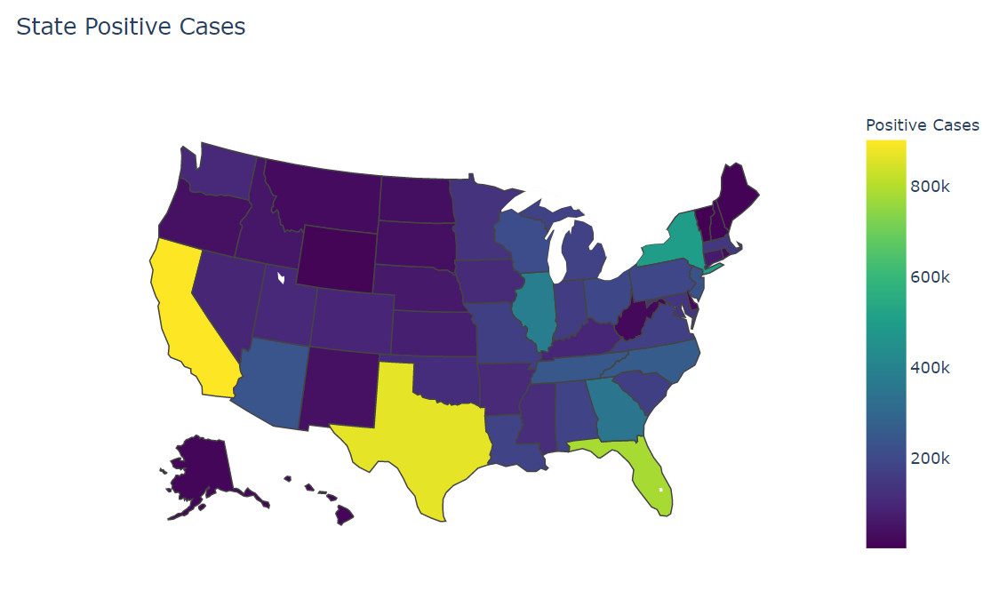
Notes:
Cody

Slide 14
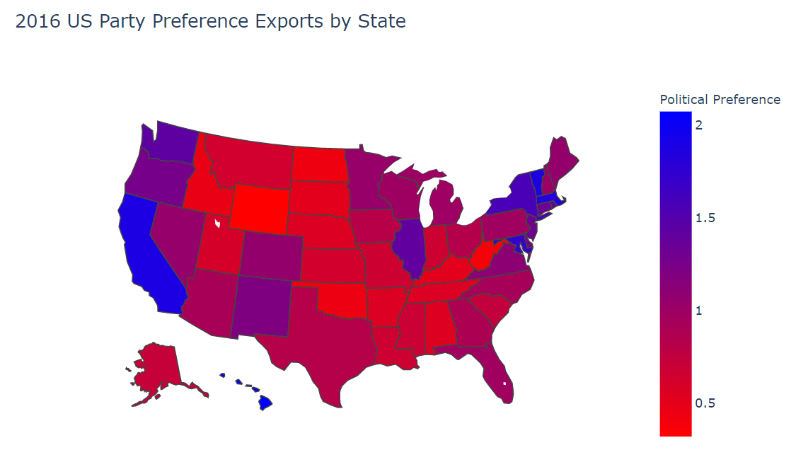
Notes:
Cody

Slide 15
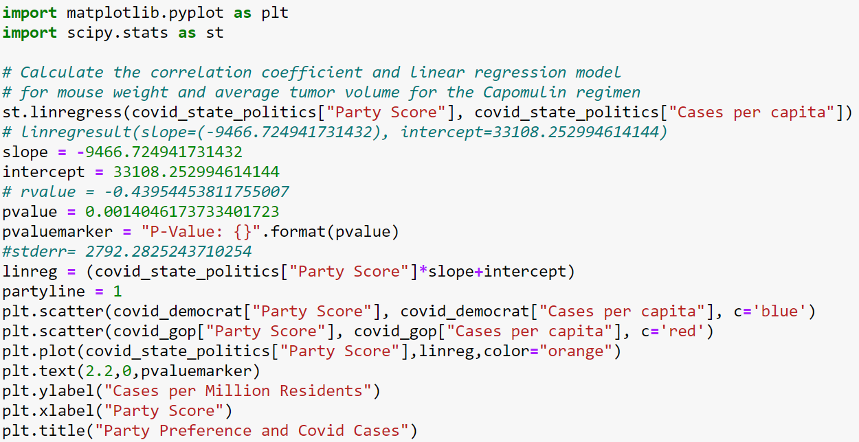
Linear Regression Scatterplot Code Example: COVID Cases per 1 M Residents of US states
*insert code for scatterplot linear regression*
Notes:
Daniel

Slide 16
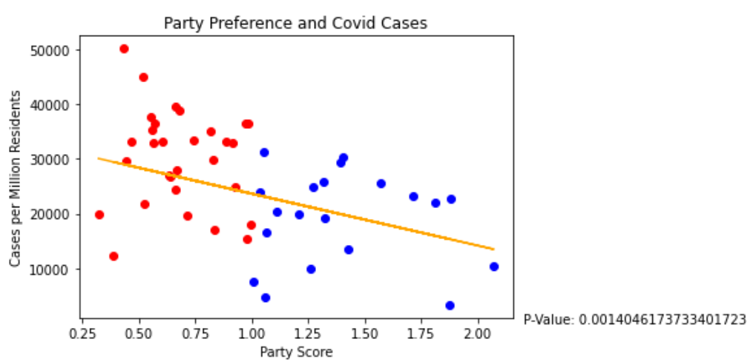
Notes:
Daniel

Slide 17
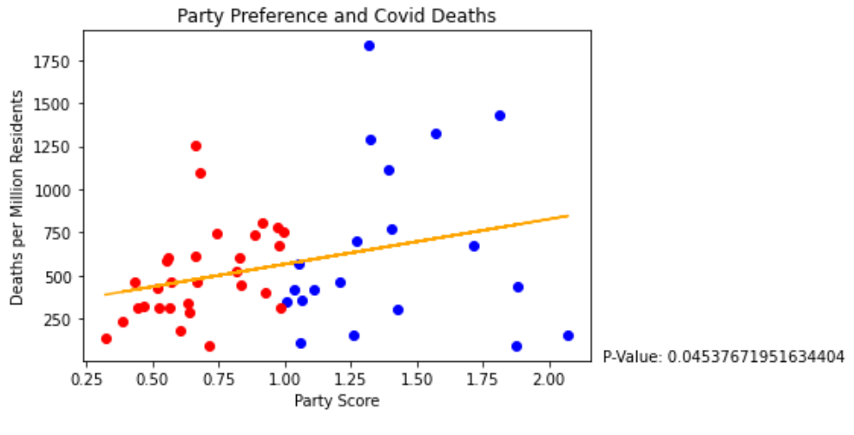
Notes:
Daniel

Slide 18
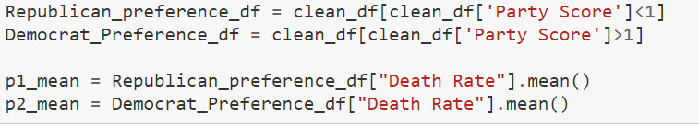
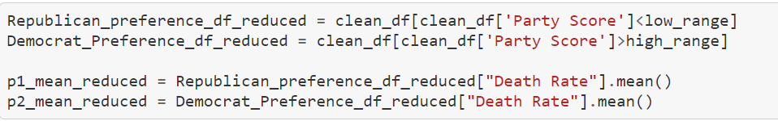
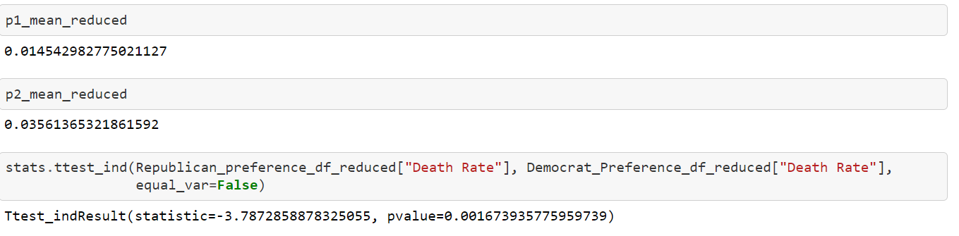
Statistics Code: Independent Sample T-Test of Death Rate by State Based on Party Preference
Notes:
Jackie

Slide 19
Hypothesis Testing with Independent Sample T-Test
Null Hypothesis: There is no difference in COVID19 death rates in US states based on political preference
Alternative Hypothesis: Political preference is correlated to a difference in COVID19 death rates in US states
 | Political Preference | N (States/Party) | Mean (Deaths/Case) | Test Statistic | P-Value
COVID19 Death Rate | Republican | 30 | 0.01454 | -3.78729 | 0.00167
 | Democrat | 20 | 0.03561
Notes:
Jackie

Slide 20
Conclusions of Analysis
2. Data suggests contracting COVID19 more likely in red states, but surviving more likely in blue states
Political Variables potentially at play:
Higher mask wearing compliance in blue states results in fewer cases
Non-political variables potentially at play:
Population densities
Climate
Geographic distribution of different COVID19 strains
1. Geographically, most COVID19 death hotspots located in Northeastern United States
Potentially due to influence of climate
Higher population densities on average
Notes:
Fatima

Slide 21
Final Thoughts
Correlation =/= Causation
While we discovered a trend relating state political preference to COVID19 Outcomes, its dangerous to draw conclusions based on such a limited analysis of variables!
Notes:
Fatima

